Slide 1
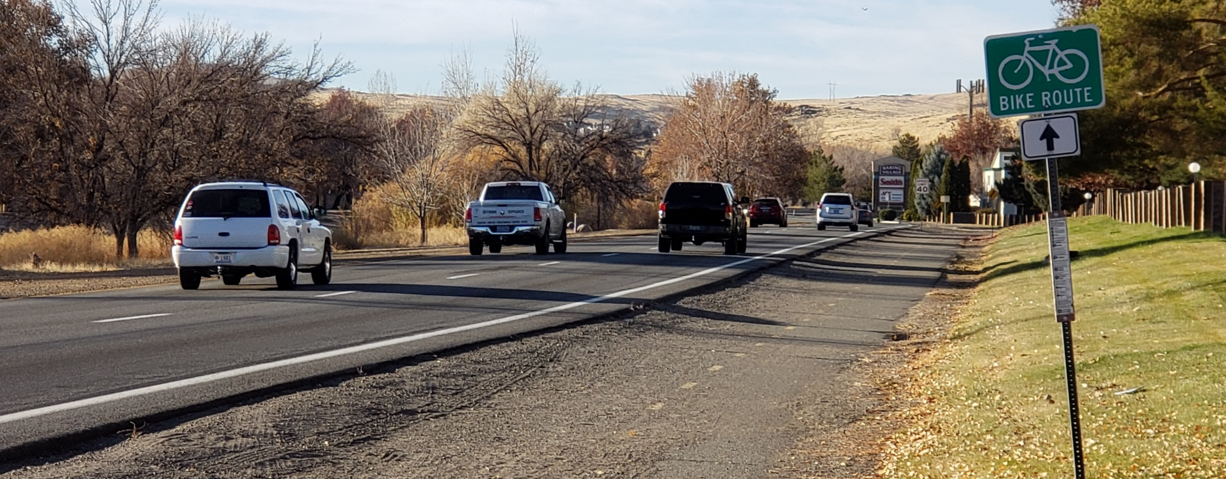
Sparks Boulevard Project - Update
City of Sparks City Council
April 26, 2021

Slide 2
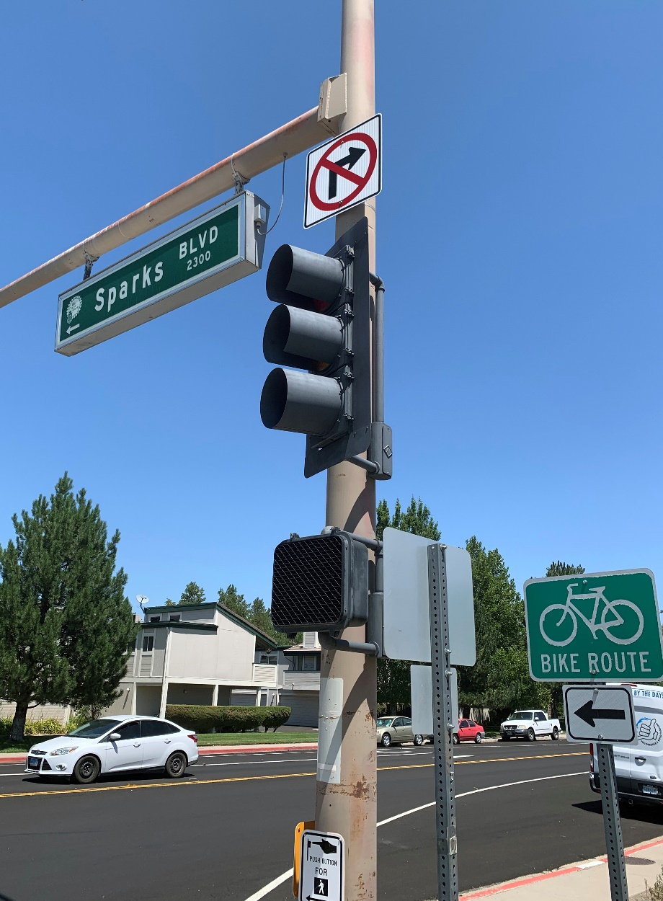
Sparks Boulevard Project – Council Update
Review Purpose and Need of Project
Preferred Alternative Recommendations
Review Project Phasing Plan
Estimated Construction Cost
Schedule Update

Slide 3
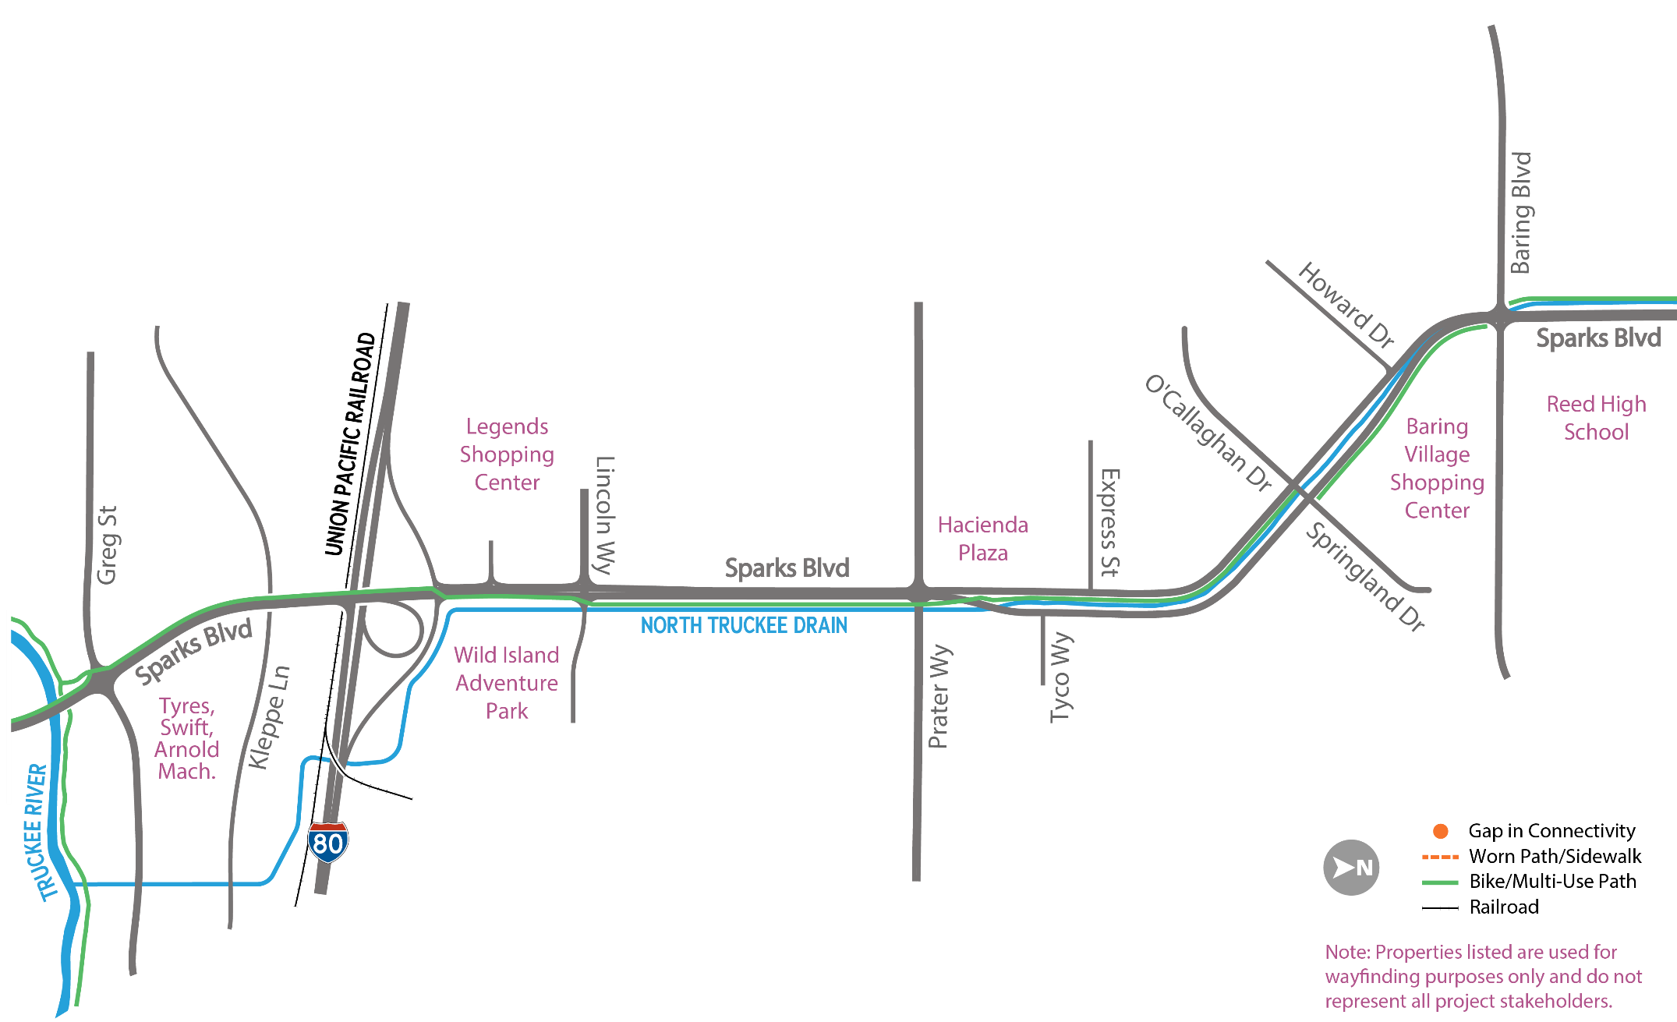
Sparks Boulevard Project – Project Purpose
Project Purpose:
Address operational and capacity deficiencies
Improve connectivity, safety, and mobility for all modes of transportation
Notes:
Improve connectivity, safety, and mobility for all modes of transportation, including cars, pedestrians, transit, and bicycles, along Sparks Boulevard from the I-80 westbound ramps to Baring Boulevard.
The Project is needed to address the following issues:
Expected increases to traffic volumes would result in increased travel delays along Sparks Boulevard.
Traffic safety would further degrade as higher crash rates are experienced along Sparks Boulevard.
Several locations lack safe pedestrian and bicycle connectivity and/or are not in compliance with the Americans with Disabilities Act (ADA) standards.
The Project would provide safe access to transit stops along the corridor.

Slide 4
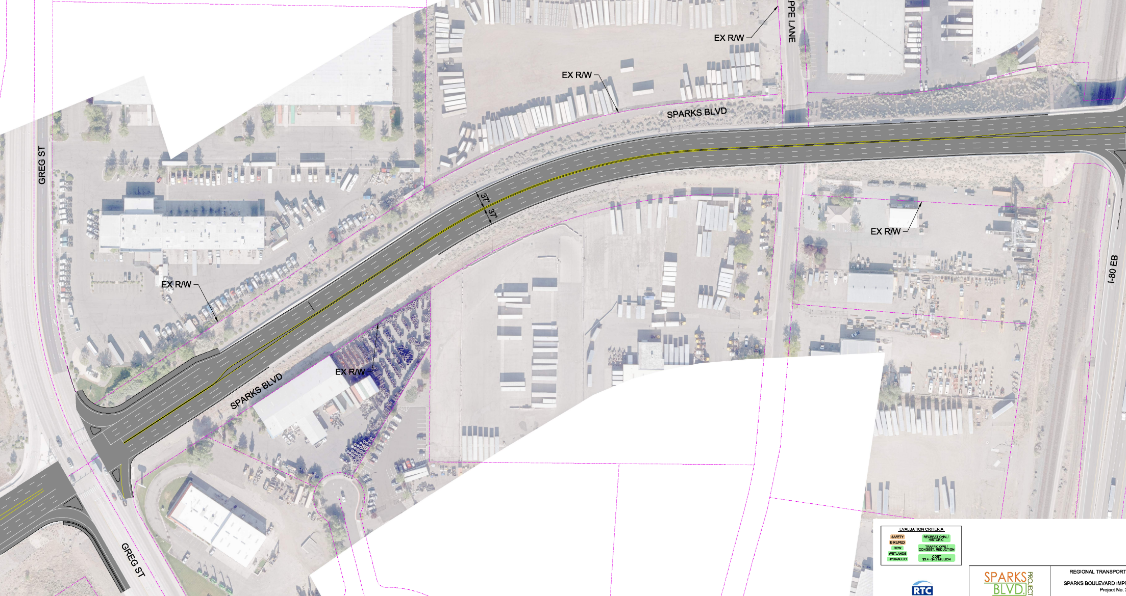
Sparks Boulevard Project – Preferred Alternative
Greg Street to Interstate 80 – Preferred Alternative
SHRED-IT
N
KLEPPE LN
VELOCITY TRUCK CENTERS
ESTES EXPRESS LINES
HERC RENTALS
TYRES INTERNATIONAL
SWIFT TRANSPORTATION
ARNOLD MACHINERY

Slide 5
Sparks Boulevard Project – Preferred Alternative
Interstate 80 Overpass – Preferred Alternative
N
I-80 EB OFF RAMP
I-80 WB ON RAMP
SPARKS BLVD
I-80 WB OFF RAMP
I-80 EB ON RAMP

Slide 6
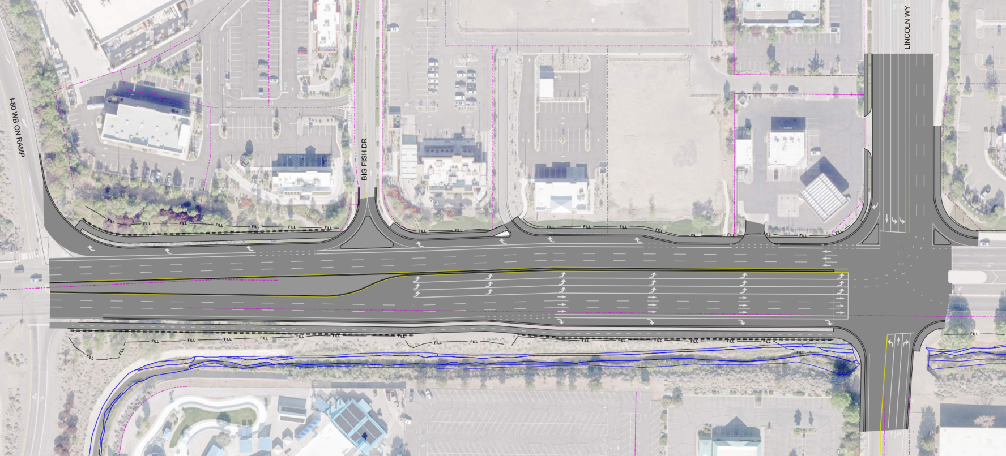
Sparks Boulevard Project – Preferred Alternative
Lincoln to Interstate 80 Segment – Preferred Alternative
LOWES HOME IMPROVEMENT
LEGENDS SHOPPING CENTER
LINCOLN WAY
SPARKS BLVD
N
WILD ISLAND ADVENTURE PARK

Slide 7
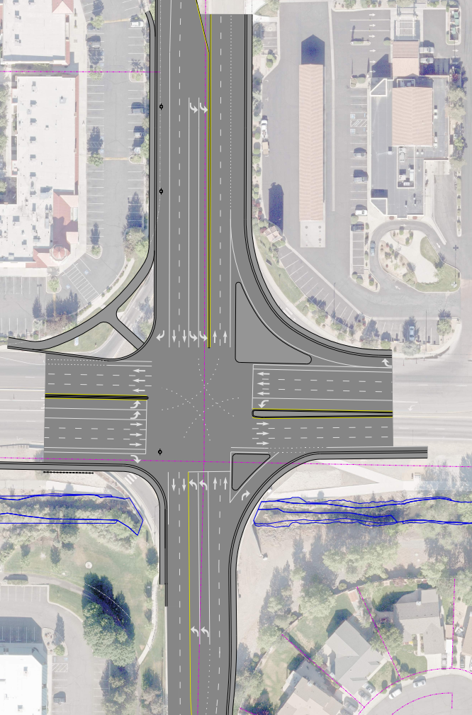
Sparks Boulevard Project – Preferred Alternative
Prater Way Intersection – Preferred Alternative
MARINA MARKETPLACE
E. PRATER WY
HACIENDA PLAZA
SPARKS BLVD
SPARKS JUSTICE COURT
N

Slide 8
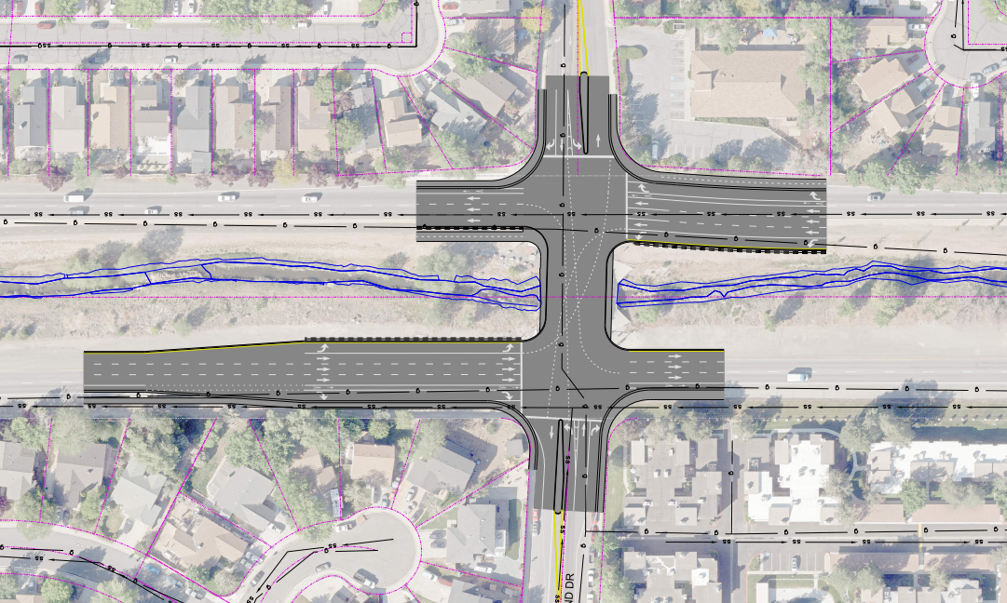
Sparks Boulevard Project – Preferred Alternative
Springland Drive and O’Callaghan Drive Intersection – Preferred Alternative
N
O’CALLAGHAN DR
SPARKS BLVD
SPARKS BLVD
SPRINGLAND DR

Slide 9
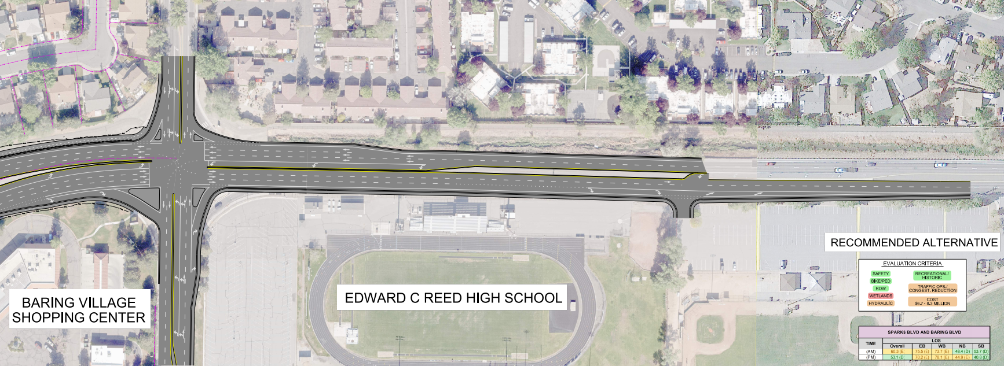
Sparks Boulevard Project – Preferred Alternative
Baring Boulevard Intersection – Preferred Alternative
N
SPARKS BLVD
BARING BLVD

Slide 10
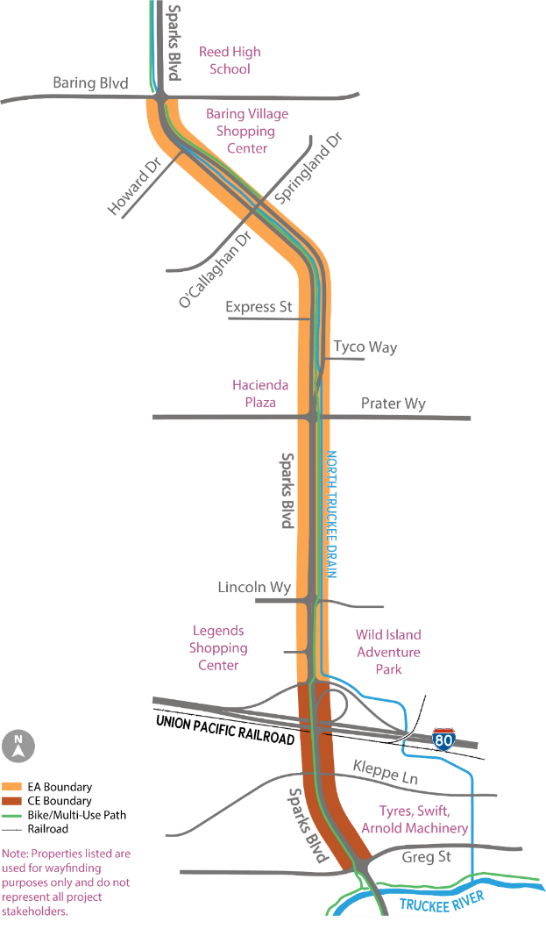
Sparks Boulevard Project – Phasing
Phase 1 – Greg St to WB I-80 Ramps
Pavement rehabilitation and restriping to 3 lanes within segment
No bridge widening, maintain shared use path
2022 construction season
Approximately $5 million construction cost
Phase 2 – WB I-80 Ramps to Baring Blvd
Widening to 3 lanes, roadway rehabilitation
Maintain shared use path, bike lanes
2024/2025 construction
Approximately $60 million construction cost
Future Project – Interchange Improvements
Multimodal expansion
NDOT interchange coordination
Construction TBD
N

Slide 11
Sparks Boulevard Project – Schedule
Environmental Process
Construction
Phase 1
Construction
Phase 2
Spring 2019 – Summer 2022
Spring 2022
2024 - 2025
2021
2022 - 2023
Design
Phase 1
Design
Phase 2

Slide 12
THANK YOU!
Jeff Wilbrecht
Project Manager
Regional Transportation Commission of Washoe County
jwilbrecht@rtcwashoe.com
rtcwashoe.com
Your RTC. Our Community.

